Slide 1
Project 2
Mark Anthony Duero

Slide 2
Exploratory Data Analysis (EDA)
Your hometown mayor just created a new data analysis team to give policy advice, and the administration recruited you via LinkedIn to join it. Unfortunately, due to budget constraints, for now the "team" is just you...
The mayor wants to start a new initiative to move the needle on one of two separate issues: high school education outcomes, or drug abuse in the community.
Also unfortunately, that is the entirety of what you've been told. And the mayor just went on a lobbyist-funded fact-finding trip in the Bahamas. In the meantime, you got your hands on two national datasets: one on SAT scores by state, and one on drug use by age. Start exploring these to look for useful patterns and possible hypotheses!
In statistics, exploratory data analysis (EDA) is an approach to analyzing data sets to summarize their main characteristics, often with visual methods.

Slide 3

The Mayor in Bahamas

Slide 4

Questions 1 – 6

Slide 5

Questions 7...

Slide 6
1. Load the sat_scores.csv
Read until all keys are created
  Read until all columns are processed
    Loop until all rows are processed
      Convert 'Rate', 'Verbal', 'Math' to integers
      Append the list
  Add to the dictionary
It took me 3 days to complete this task.

Slide 7
A simple code with huge impact
sat_scores_csv = './sat_scores.csv'
sat_scores = pd.read_csv(sat_scores_csv).to_dict(orient='list')

Slide 8


Slide 9
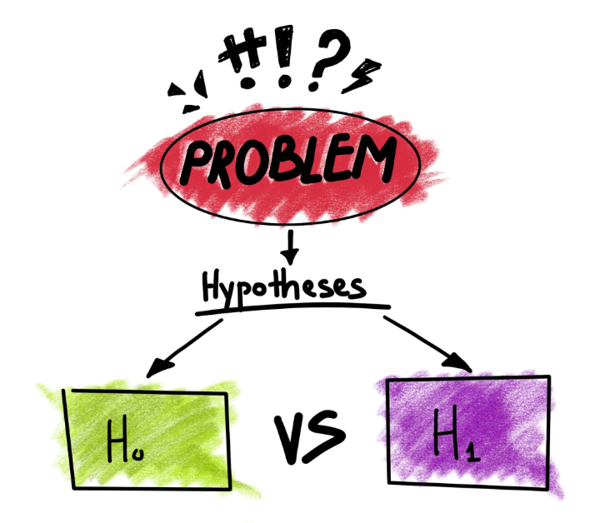

Slide 10

then

Slide 11
8. Introduction to dealing with outliers
outliers=[]
def detect_outlier(data_1):
threshold=3
mean_1 = np.mean(data_1)
std_1 =np.std(data_1)
for y in data_1:
z_score= (y - mean_1)/std_1
if np.abs(z_score) > threshold:
outliers.append(y)
return outliers

Slide 12


